Slide 1

CSE (H) with specialization in Machine Learning and Artificial Intelligence
Soft Computing (20CST-345)
Chapter -3.2
Introduction to Fuzzy Systems
By: Dr. Monika Singh E11032
DISCOVER . LEARN . EMPOWER

Slide 2
Course Objectives
To introduce soft computing concepts and techniques of artificial neural networks, fuzzy sets, fuzzy logic and genetic algorithms
To understand the various techniques from the application point of view.
To analyze various soft computing techniques and decide the technique to be used in a particular problem situation.
To implement soft computing based solutions for real-world problems
DISCOVER . LEARN . EMPOWER

Slide 3
Course Outcomes
CO1 | Identify and describe soft computing techniques and their roles in building intelligent. Machines | 1
CO2 | Recognize the feasibility of applying a soft computing methodology for a particular problem. | 2,4
CO3 | Apply fuzzy logic and reasoning to handle uncertainty and solve engineering problems, genetic algorithms to combinatorial optimization problems and neural networks to pattern classification and regression problems. | 3
CO4 | Effectively use modern software tools to solve real problems using a soft computing approach. | 3
CO5 | Evaluate various soft computing approaches for a given problem. | 4
DISCOVER . LEARN . EMPOWER

Slide 4
Table of Contents
Fuzzy Rule based systems, Predicate logic, Fuzzy Decision Making, Fuzzy Control Systems, Fuzzy Classification., Minmax Composition, Defuzzification Method.
DISCOVER . LEARN . EMPOWER

Slide 5

Introduction to Fuzzy Systems
DISCOVER . LEARN . EMPOWER

Slide 6
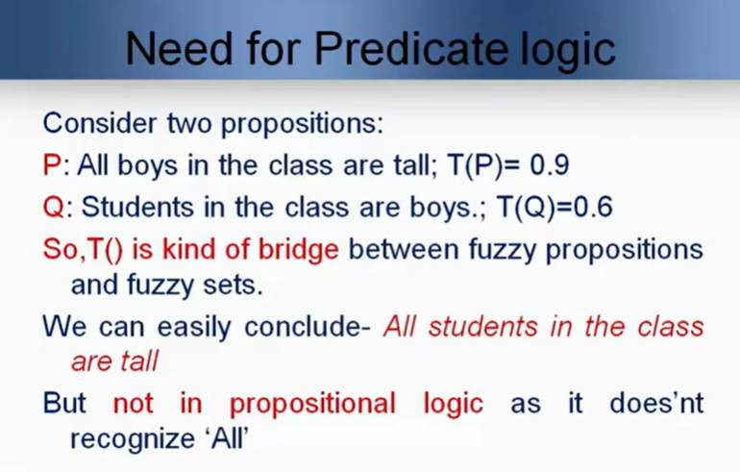

Slide 7
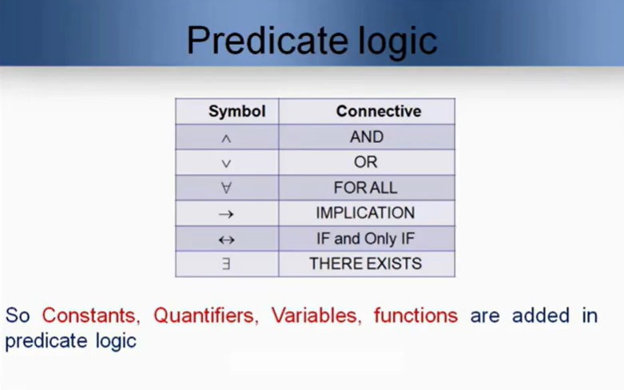

Slide 8
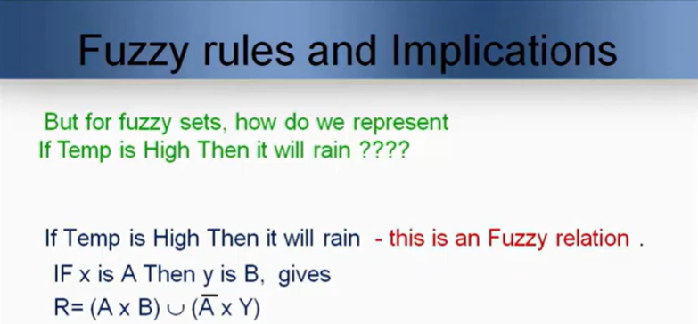

Slide 9
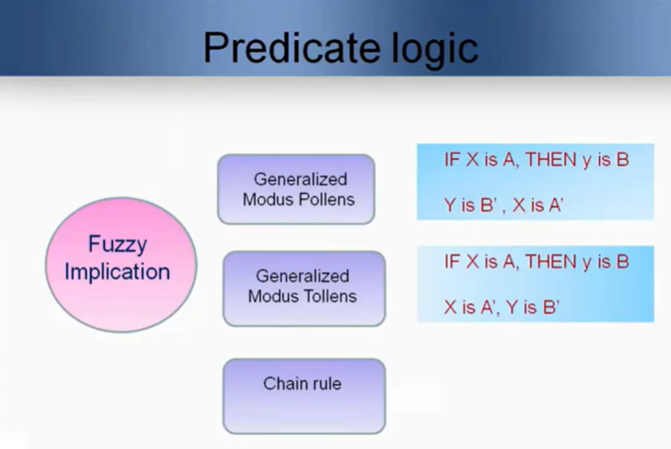
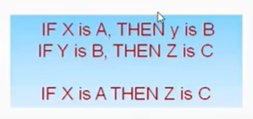

Slide 10
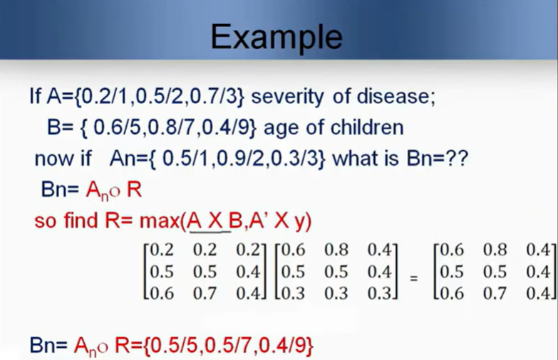

Slide 11
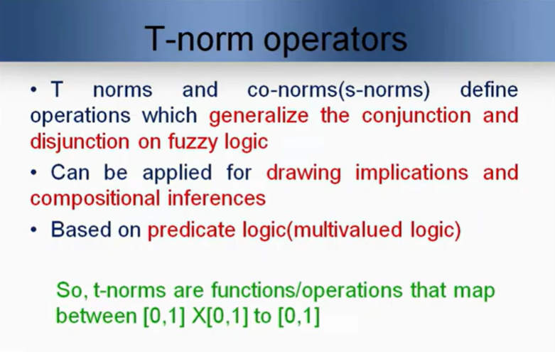

Slide 12
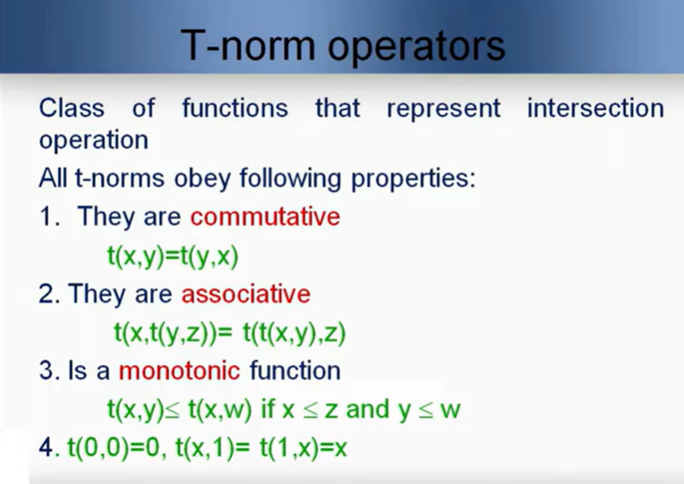

Slide 13
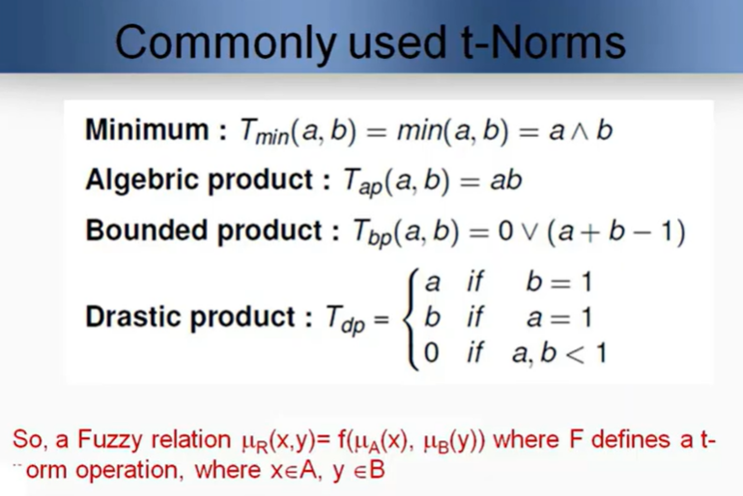

Slide 14
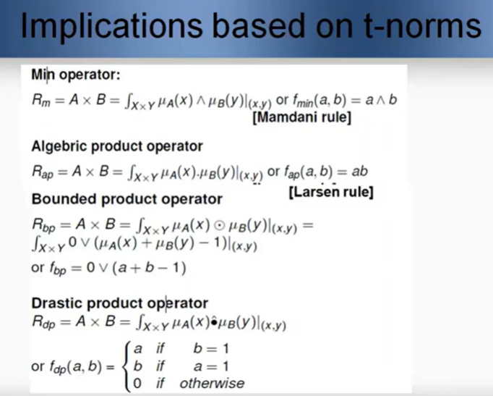

Slide 15
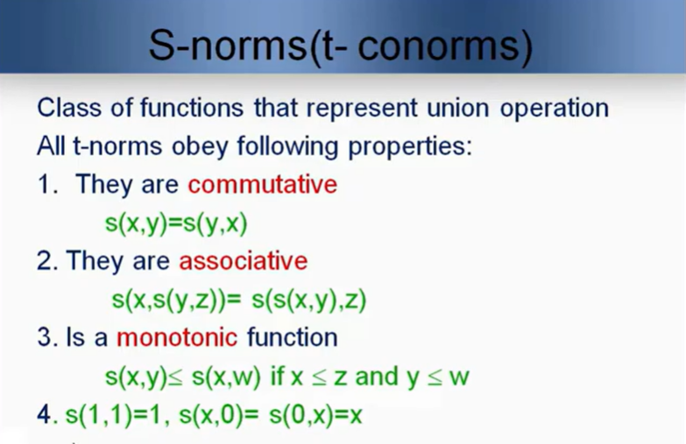

Slide 16
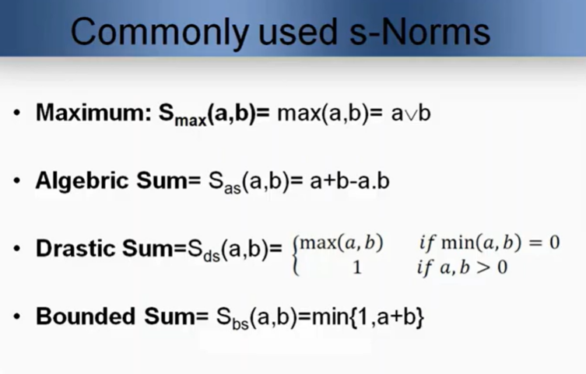

Slide 17
References
TEXT BOOKS
T1. Timothy J. Ross, “Fuzzy Logic with Engineering Applications”.
T2. S.N.Sivanandam, S.N Deepa, “Principles of Soft Computing”
T3. Lofti Zadeh “Fuzzy Logic and Soft Computing” Word Scientific, 1995.
T4 Samir Roy,Udit Chakraborty, “Introduction to Soft Computing:Neuro-Fuzzy and Genetic Algorithms”, Pearson.
REFERENCE BOOKS
R1. Bart Kosko, “Neural Network and Fuzzy Systems: A Dynamic System Approach to Machine” Prentice-Hall 1998
R2. Fausett, “Fundamentals of Neural Networks: Architectures, Algorithms, and Applications”, Prentice-Hall, 1994
R3. Jack M. Zurada, “Introduction to Artificial Neural Systems”, PWS Publishing Co., Boston, 2000.
R4. J S R Jang, “Neuro-Fuzzy & Soft Computing,”, Pearson.
DISCOVER . LEARN . EMPOWER

Slide 18
Journal Papers
1. C.A. Peña-Reyes. Evolutionary fuzzy modelling human diagnostic decisions. Annals of the New York Academy of Sciences, pages 190-211, May 2004. DOI – PDF
2. C.A. Peña-Reyes and M. Sipper. Evolutionary computation in medicine: An overview. Artificial Intelligence in Medicine, 19(1):1-23, May 2000. DOI
3. C.A. Peña-Reyes and M. Sipper. A fuzzy-genetic approach to breast cancer diagnosis. Artificial Intelligence in Medicine, 17(2):131-155, October 1999. DOI – PDF
4. Jungang Liu, Student Member, IEEE, and Oliver W. W. Yang, Senior Member, IEEE, “Using Fuzzy Logic Control to Provide Intelligent Traffic Management Service for High-Speed Networks”, IEEE TRANSACTIONS ON NETWORK AND SERVICE MANAGEMENT, VOL. 10, NO. 2, JUNE 2013.
Web links
(1) http://staff.cs.upt.ro/~todinca/cad/Lectures/cad_fuzzysets.pdf (2) Principles of Soft Computing
DISCOVER . LEARN . EMPOWER

Slide 19
THANK YOU
For queries
Email: monika.e11032@cumail.in

